Slide 1
The Changing Role of Medication
in Advancing Recovery
NYAPRS Conference

Slide 2
Martin Harrow’s Long-Term Study of
Psychotic Patients
Patient Enrollment
64 schizophrenia patients
81 patients with other psychotic disorders
37 psychotic bipolar patients
28 unipolar psychotic patients
16 other milder psychotic disorders
Median age of 22.9 years at index hospitalization
Previous hospitalization
46% first hospitalization
21% one previous hospitalization
33% two or more previous hospitalizations
Source: Harrow M. “Factors involved in outcome and recovery in schizophrenia patients not on antipsychotic medications.” Journal of Nervous and Mental Disease 195 (2007):406-14.

Slide 3
Long-term Recovery Rates for
Schizophrenia Patients
50%
40% 30% 20% |  | Off Antipsychotics
10%
On Antipsychotics
0%
2 years 4.5 years 7.5 years 10 years 15 years
Source: Harrow M. “Factors involved in outcome and recovery in schizophrenia patients not on antipsychotic medications.” Journal of Nervous and Mental Disease 195 (2007):406-14.

Slide 4
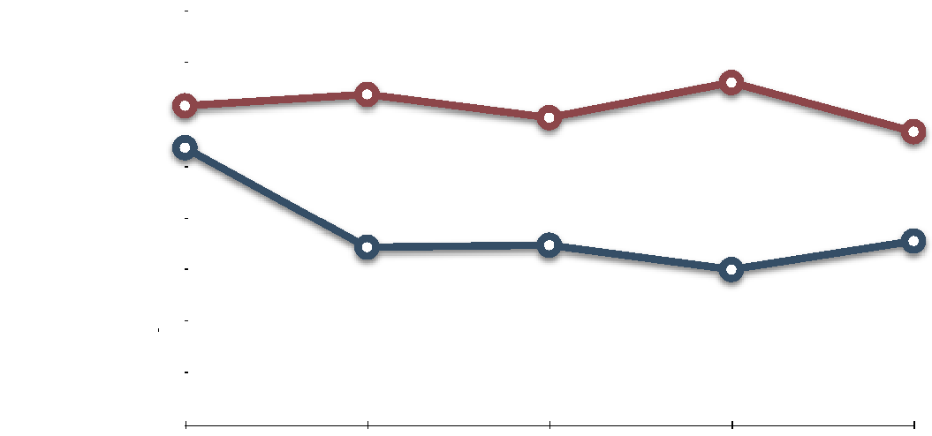
Global Adjustment of Schizophrenia Patients
Worst outcomes
8
On Antipsychotics Off Antipsychotics
7
6
5
4
3
2
Best outcomes
1
0
2 years 4.5 years 7.5 years 10 years 15 years
Source: Harrow M. “Factors involved in outcome and recovery in schizophrenia patients not on antipsychotic medications.” Journal of Nervous and Mental Disease 195 (2007):406-14.

Slide 5
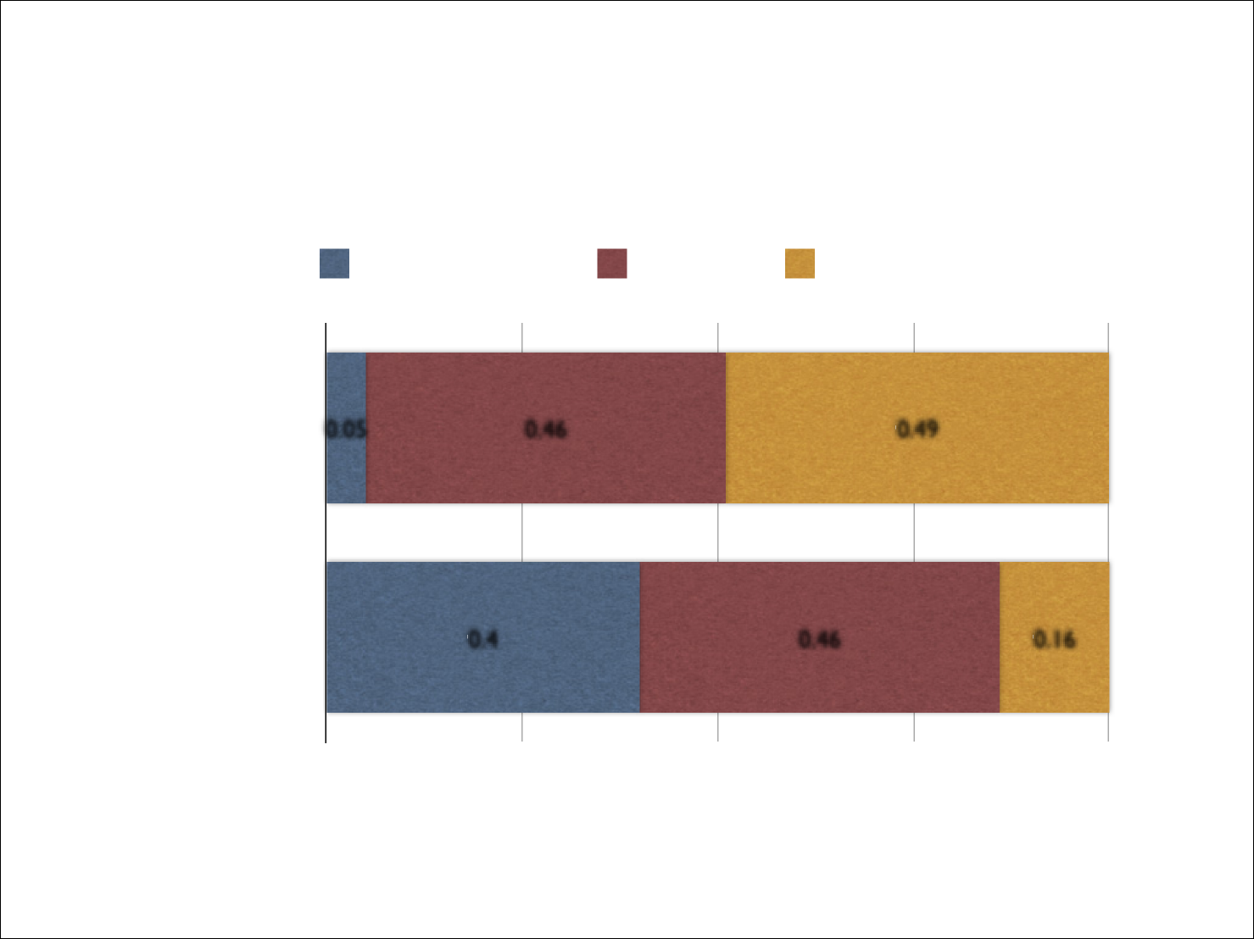
Spectrum of Outcomes in Harrow’s Study
Recovered FairUniformly Poor
On Antipsychotics
0.05
0.46
0.49
Off Antipsychotics
0 . 4
0.46
0.1 6
0%25%50%75%100%
Source: Harrow M. “Factors involved in outcome and recovery in schizophrenia patients not on antipsychotic medications.” Journal of Nervous and Mental Disease 195 (2007):406-14.

Slide 6
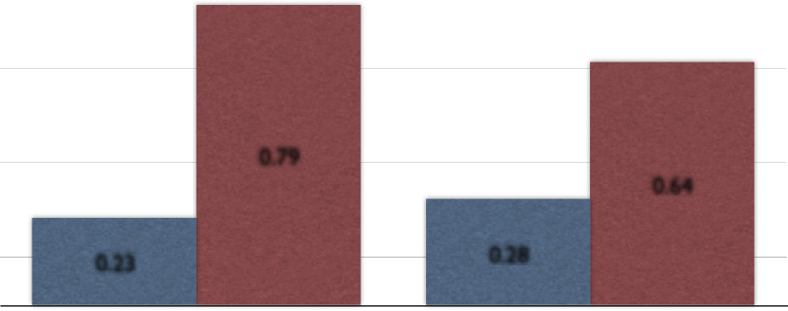
Schizophrenia Patients Experiencing
Psychotic Symptoms Over the Long Term
O ff antipsychotics On Antipsychotics
100%
75%
50%
0.79
0.64
25%
0. 23
0.28
0%
10-year followup 15-year followup
Source: Harrow M. “Factors involved in outcome and recovery in schizophrenia patients not on antipsychotic medications.” Journal of Nervous and Mental Disease 195 (2007):406-14.

Slide 7
Global Adjustment of “Other Psychotic” Patients
Worst outcomes | 8
 | 7
6 5 4 3 2 |  | On Antipsychotics Off Antipsychotics
1
Best outcomes | 0
 | 2 years 4.5 years 7.5 years 10 years 15 years
Source: Harrow M. “Factors involved in outcome and recovery in schizophrenia patients not on antipsychotic medications.” Journal of Nervous and Mental Disease 195 (2007):406-14.

Slide 8
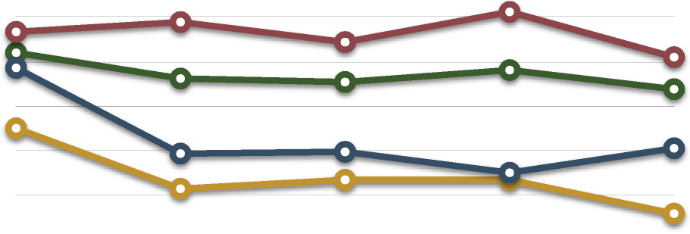
Global Adjustment of All Psychotic Patients
Worst outcomes
8
7 6 5 4 3 2 |  | Schizophrenia On Meds Other Disorders On Meds Schizophrenia Off Meds Other Disorders Off Meds
Best outcomes
1 0
2 years 4.5 years 7.5 years 10 years 15 years
Source: Harrow M. “Factors involved in outcome and recovery in schizophrenia patients not on antipsychotic medications.” Journal of Nervous and Mental Disease 195 (2007):406-14.

Slide 9
“In addition, global outcome for the group of
patients with schizophrenia who were on
antipsychotics was compared with the off-
medication schizophrenia patients with
similar prognostic status. Starting with the
4.5-year follow-up and extending to the 15-
year follow-up, the off-medication subgroup
tended to show better global outcomes at
each followup.”
Martin Harrow, page 411.

Slide 10
Five-Year Outcomes for First-Episode Psychotic Patients in Finnish
Western Lapland Treated with Open-Dialogue Therapy
Patients (N=75)
Schizophrenia (N=30) Other psychotic disorders (N=45)
Antipsychotic use
Never exposed to antipsychotics Occasional use during five years Ongoing use at end of five years | 67% 33% 20%
Psychotic symptoms
Never relapsed during five years Asymptomatic at five-year followup | 67% 79%
Functional outcomes at five years
Working or in school Unemployed On disability | 73% 7% 20%
Source: Seikkula, J. “Five-year experience of first-episode nonaffective psychosis in open-dialogue approach.” Psychotherapy Research 16 (2006):214-28.

